Slide 1
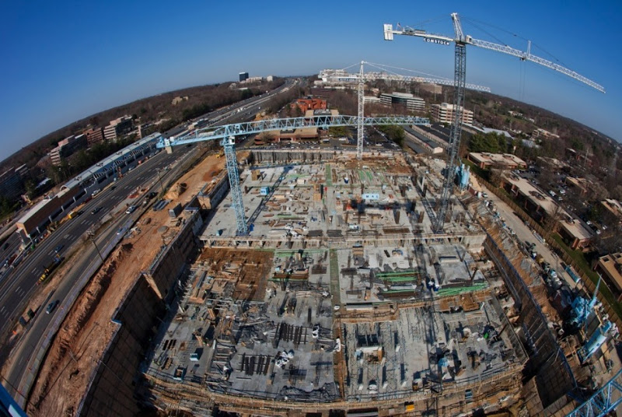
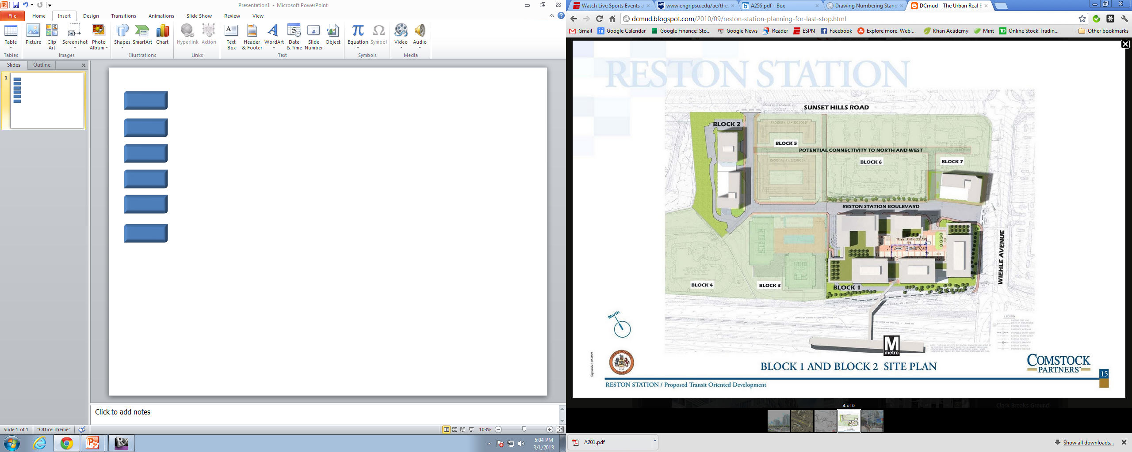
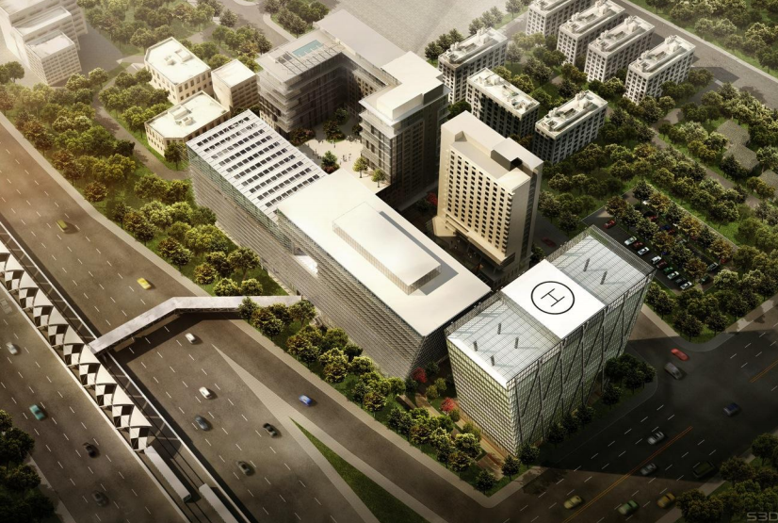
Reston Station Phase 1 Garage
Reston, Virginia
Penn State Architectural Engineering Senior Thesis
Jon Fisher Construction Option Advisor: Dr. Robert Leicht

Slide 2

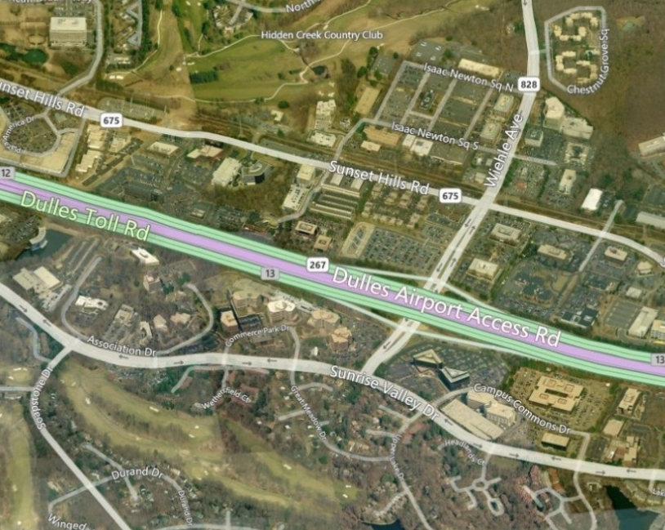


Project Overview
Reston Station Phase 1 Garage
Reston, Virginia
Jon Fisher | Construction Management
OUTLINE
Project Overview
Analysis #1: Public-Private Partnerships
Analysis #2: Bonded Warehouses
Analysis #3: SIPS Scheduling
Analysis #4: Mechanical Chases
Summary and Conclusions
Acknowledgements
Location
Reston, Virginia
Size
1.3 Million Square Feet
7 Underground Levels
5 Additional Buildings in Future Phases
Function
2300 Public Parking Spaces
Silver Line Metrorail
Schedule
April 2011 – July 2013
27 Months

Slide 3
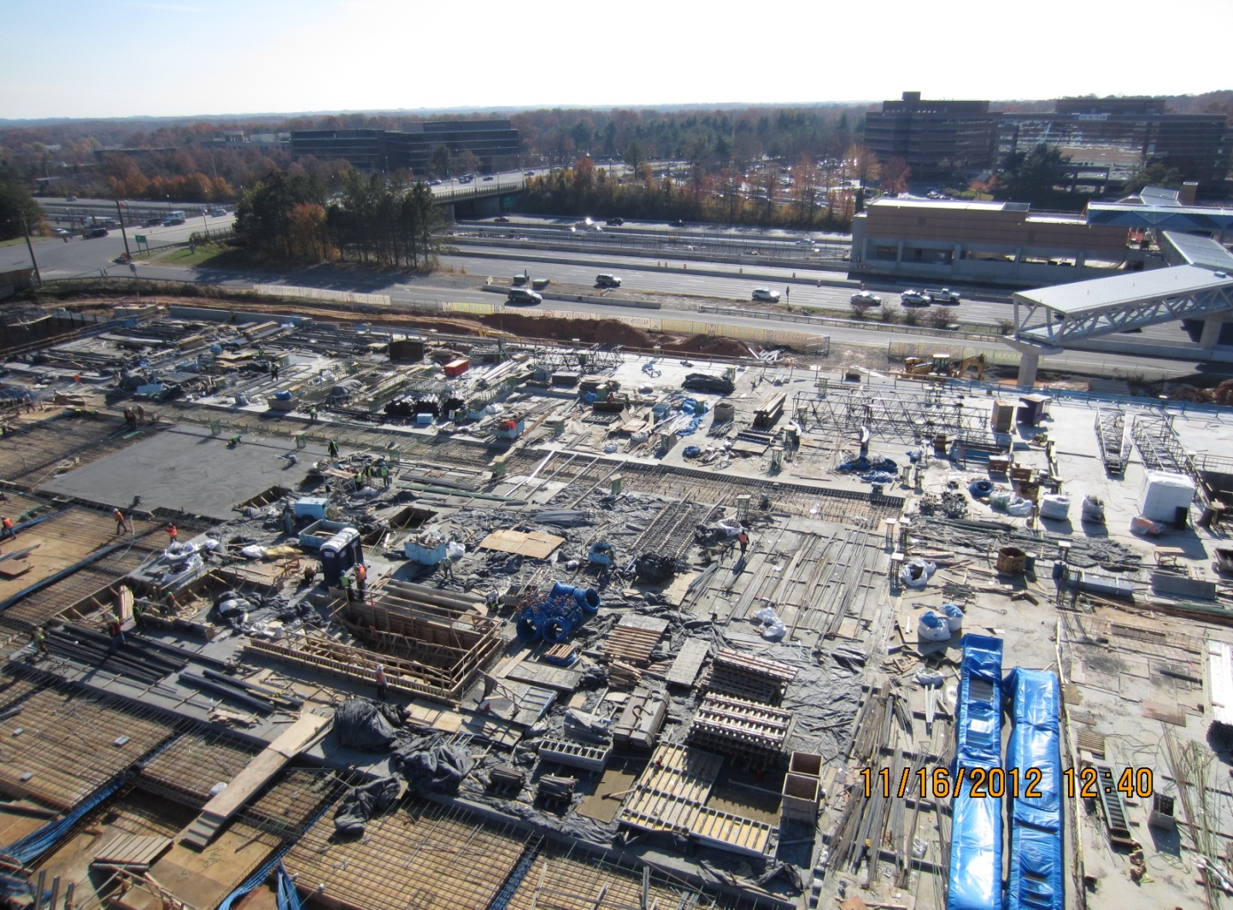
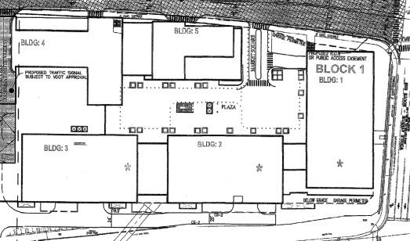
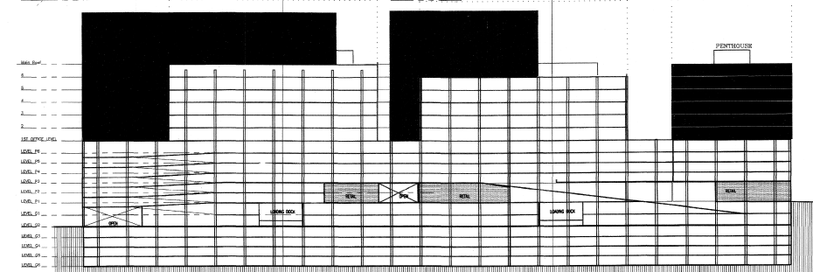

Project Overview
Reston Station Phase 1 Garage
Reston, Virginia
Jon Fisher | Construction Management
OUTLINE
Project Overview
Analysis #1: Public-Private Partnerships
Analysis #2: Bonded Warehouses
Analysis #3: SIPS Scheduling
Analysis #4: Mechanical Chases
Summary and Conclusions
Acknowledgements
Cost
$92 Million
Delivery Method
Guaranteed Maximum Price
CM at Risk – Davis Construction
Owner
Fairfax County and Comstock Partners

Slide 4
Public-Private Partnerships
Reston Station Phase 1 Garage
Reston, Virginia
Jon Fisher | Construction Management
OUTLINE
Project Overview
Analysis #1: Public-Private Partnerships
Analysis #2: Bonded Warehouses
Analysis #3: SIPS Scheduling
Analysis #4: Mechanical Chases
Summary and Conclusions
Acknowledgements
Goal of Analysis #1
To understand the public-private partnership used on the project and determine the implications partnerships have on construction as a whole

Slide 5
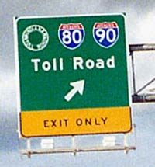
Public-Private Partnerships
Reston Station Phase 1 Garage
Reston, Virginia
Jon Fisher | Construction Management
OUTLINE
Project Overview
Analysis #1: Public-Private Partnerships
Analysis #2: Bonded Warehouses
Analysis #3: SIPS Scheduling
Analysis #4: Mechanical Chases
Summary and Conclusions
Acknowledgements
Public-Private Partnership: “A government service or private business venture funded and operated through a partnership of government and one or more private sector companies.”
PPP’s In Construction
Simple Example: Toll Roads
Sharing risk and reward
When government and the private sector work together

Slide 6
Public-Private Partnerships
Reston Station Phase 1 Garage
Reston, Virginia
Jon Fisher | Construction Management
OUTLINE
Project Overview
Analysis #1: Public-Private Partnerships
Analysis #2: Bonded Warehouses
Analysis #3: SIPS Scheduling
Analysis #4: Mechanical Chases
Summary and Conclusions
Acknowledgements
PPP At Reston Station
County given development funds from VDOT
Fairfax approached by Comstock for future building rights
Virginia Public-Private Partnership Act
99-year lease
Proffer agreement contains terms
Price tag divided by parking ratio
Advantages of Public Private Partnerships
Public Owner | Private Owner
● Reduced Cost | ● Operation in New Markets
● Delivery Method Freedom | ● New Revenue Opportunity
● Possible Increase in Revenue | ● Government Relationship
● Increased Efficiency

Slide 7
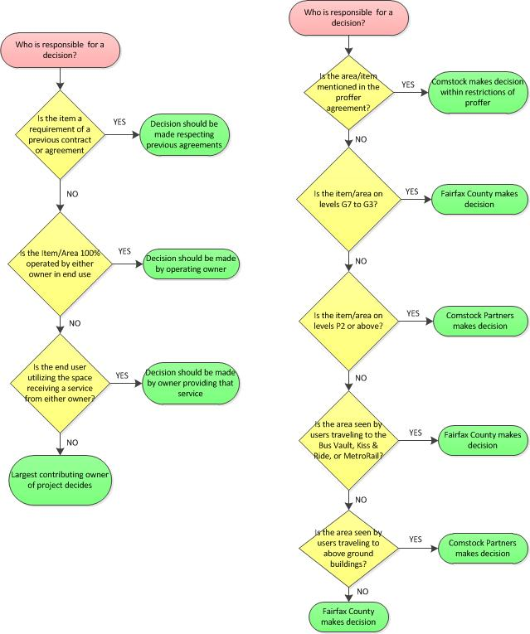
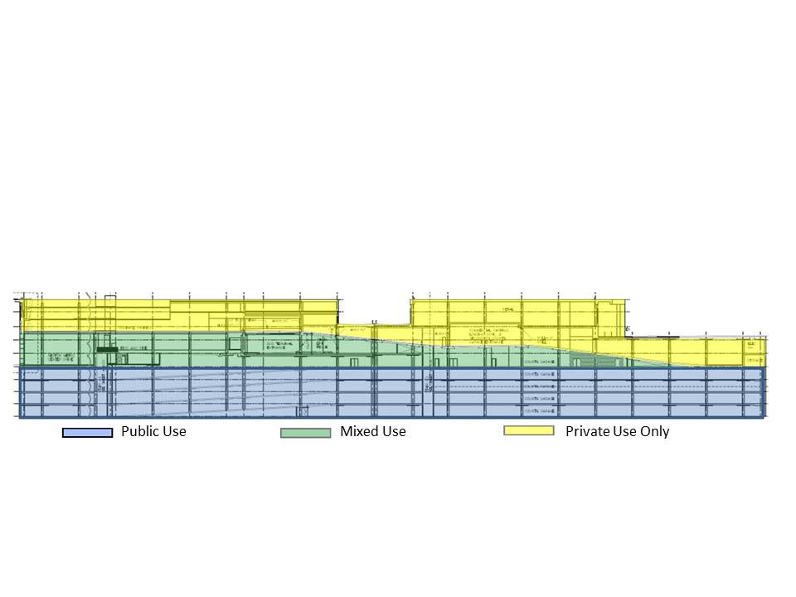
Public-Private Partnerships
Reston Station Phase 1 Garage
Reston, Virginia
Jon Fisher | Construction Management
OUTLINE
Project Overview
Analysis #1: Public-Private Partnerships
Analysis #2: Bonded Warehouses
Analysis #3: SIPS Scheduling
Analysis #4: Mechanical Chases
Summary and Conclusions
Acknowledgements
Challenges
Reston Station Decision Making
Generalized Decision Making
Usage of Garage Area
Decision Making
Limited conflicts in separated areas
Decision making paralysis on shared spaces
Decision making flow chart

Slide 8
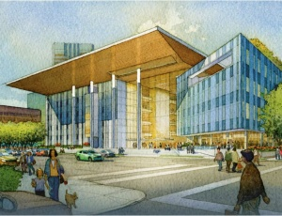
Public-Private Partnerships
Reston Station Phase 1 Garage
Reston, Virginia
Jon Fisher | Construction Management
OUTLINE
Project Overview
Analysis #1: Public-Private Partnerships
Analysis #2: Bonded Warehouses
Analysis #3: SIPS Scheduling
Analysis #4: Mechanical Chases
Summary and Conclusions
Acknowledgements
Conclusion
PPP’s are great in theory but still untested with general building construction
Best to proceed in a PPP with critical awareness
Large variance between different levels and states
Long Beach Courthouse
Not a transportation example
Long Beach Judicial Partners LLC
  Clack Design-Build
  AECOM
  Johnson Controls
$490 Million Design-Build-Operate-Maintain
Performance based service fee
Funding source complications

Slide 9
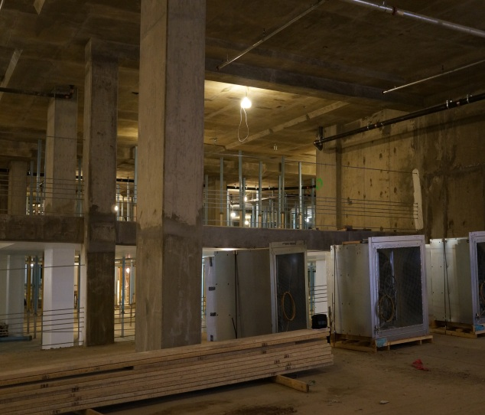
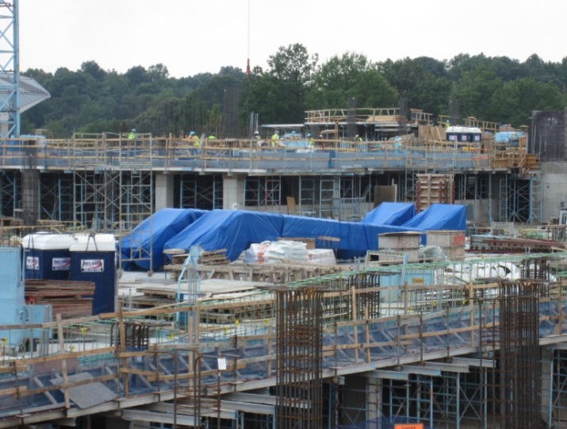
Equipment Staging and Bonded Warehouses
Reston Station Phase 1 Garage
Reston, Virginia
Jon Fisher | Construction Management
OUTLINE
Project Overview
Analysis #1: Public-Private Partnerships
Analysis #2: Bonded Warehouses
Analysis #3: SIPS Scheduling
Analysis #4: Mechanical Chases
Summary and Conclusions
Acknowledgements
Goal of Analysis #2
To investigate an alternative option for the storage of construction materials utilizing off-site bonded warehouses

Slide 10
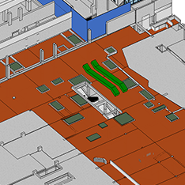
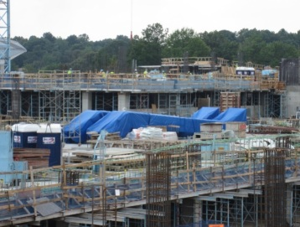

Equipment Staging and Bonded Warehouses
Reston Station Phase 1 Garage
Reston, Virginia
Jon Fisher | Construction Management
OUTLINE
Project Overview
Analysis #1: Public-Private Partnerships
Analysis #2: Bonded Warehouses
Analysis #3: SIPS Scheduling
Analysis #4: Mechanical Chases
Summary and Conclusions
Acknowledgements
Intended Storage of Escalators
Current Situation
Aug. 2, 2012
Escalator frames, ventilation fans, and stone façade
Escalators originally to be stored on finished slab
Design delay caused complications
140 fans and 2 escalators stored on slabs for extended period of time
Aug. 2, 2012

Slide 11
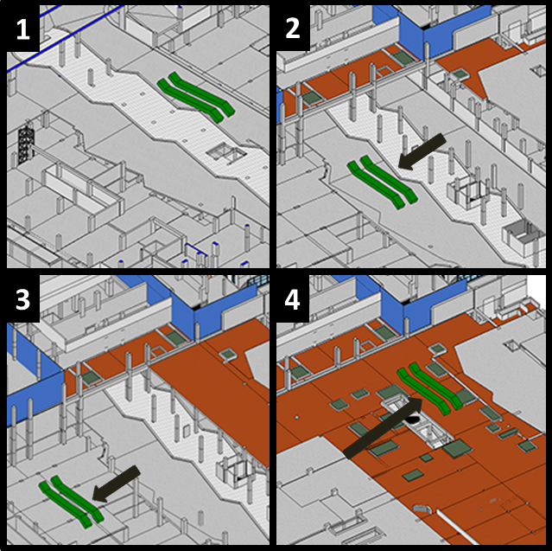
Equipment Staging and Bonded Warehouses
Reston Station Phase 1 Garage
Reston, Virginia
Jon Fisher | Construction Management
OUTLINE
Project Overview
Analysis #1: Public-Private Partnerships
Analysis #2: Bonded Warehouses
Analysis #3: SIPS Scheduling
Analysis #4: Mechanical Chases
Summary and Conclusions
Acknowledgements
Actual Storage of Escalators
Current Situation
Aug. 2, 2012
Sept. 17, 2012
Escalator frames, ventilation fans, and stone façade
Escalators originally to be stored on finished slab
Design delay caused complications
140 fans and 2 escalators stored on slabs for extended period of time
Aug. 2, 2012
Nov. 19, 2012
Dec. 3, 2012

Slide 12
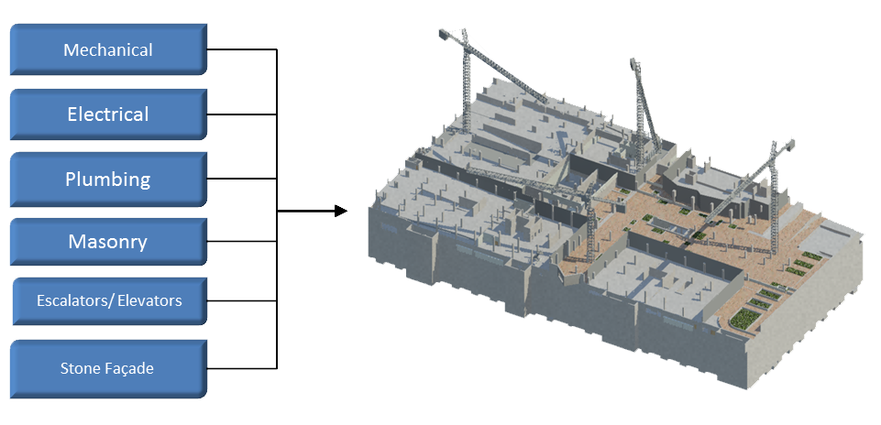
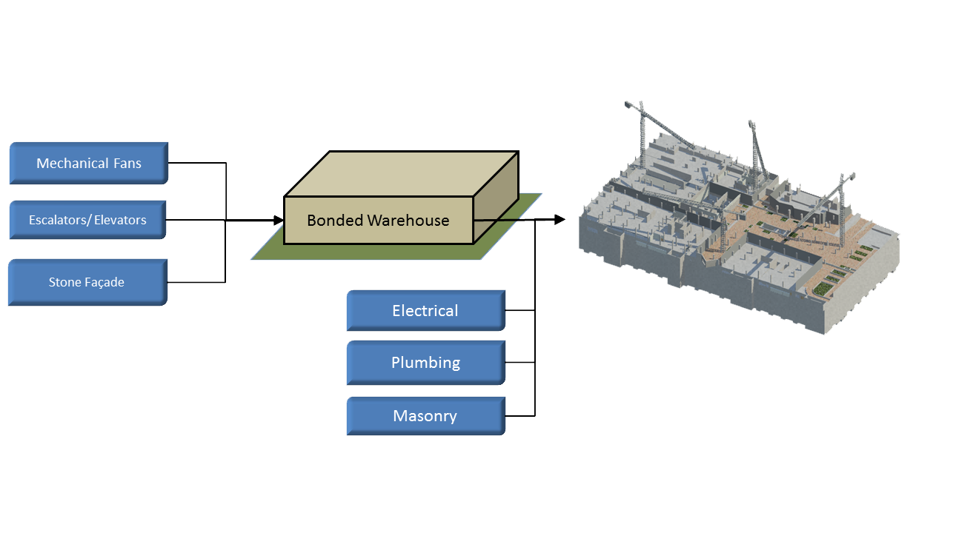
Equipment Staging and Bonded Warehouses
Reston Station Phase 1 Garage
Reston, Virginia
Jon Fisher | Construction Management
OUTLINE
Project Overview
Analysis #1: Public-Private Partnerships
Analysis #2: Bonded Warehouses
Analysis #3: SIPS Scheduling
Analysis #4: Mechanical Chases
Summary and Conclusions
Acknowledgements
How Bonded Warehouses Could Help
Typical Method of Equipment Delivery
Delivered directly to the site
Stored on site
Good for projects site freedom
The Traditional Method
Using Bonded Warehouses for Short Term
Logistics services company
Month-to-month storage
No long term contract
Sites with some restrictions
Limited Bonded Warehouse Use

Slide 13
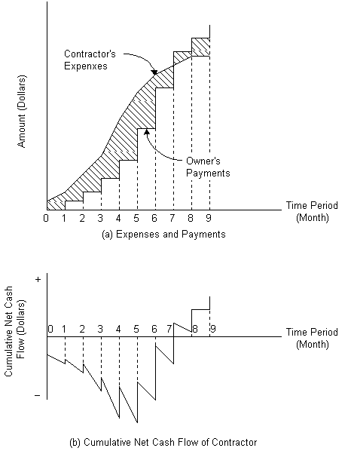
Equipment Staging and Bonded Warehouses
Reston Station Phase 1 Garage
Reston, Virginia
Jon Fisher | Construction Management
OUTLINE
Project Overview
Analysis #1: Public-Private Partnerships
Analysis #2: Bonded Warehouses
Analysis #3: SIPS Scheduling
Analysis #4: Mechanical Chases
Summary and Conclusions
Acknowledgements
Difference from Subcontractor “Yard”
Cash Flow
“§9.3.2 Unless otherwise provided in the contract document, payments shall be made on account of materials and equipment delivered and suitably store at the site for subsequent incorporation in the work. If approved in advance by the owner, payment may similarly be made for materials and equipment suitably stored off the site at a location agreed upon in writing.”
-General Conditions of the Contract for Construction
(AIA A201)

Slide 14
Equipment Staging and Bonded Warehouses
Reston Station Phase 1 Garage
Reston, Virginia
Jon Fisher | Construction Management
OUTLINE
Project Overview
Analysis #1: Public-Private Partnerships
Analysis #2: Bonded Warehouses
Analysis #3: SIPS Scheduling
Analysis #4: Mechanical Chases
Summary and Conclusions
Acknowledgements
Costs
Added stage of transportation
Month-to-Month storage
Insurance of materials
Total Cost of Off Site Storage of Limited Items
Storage Cost | $ 20,600.00
Transportation Cost | $ 7,600.00
Bonding (1% Value of Goods) | $ 8,036.00
TOTAL | $ 36,236.00
Limited Bonded Warehouse Use
Data from England Logistics & Innerspace

Slide 15
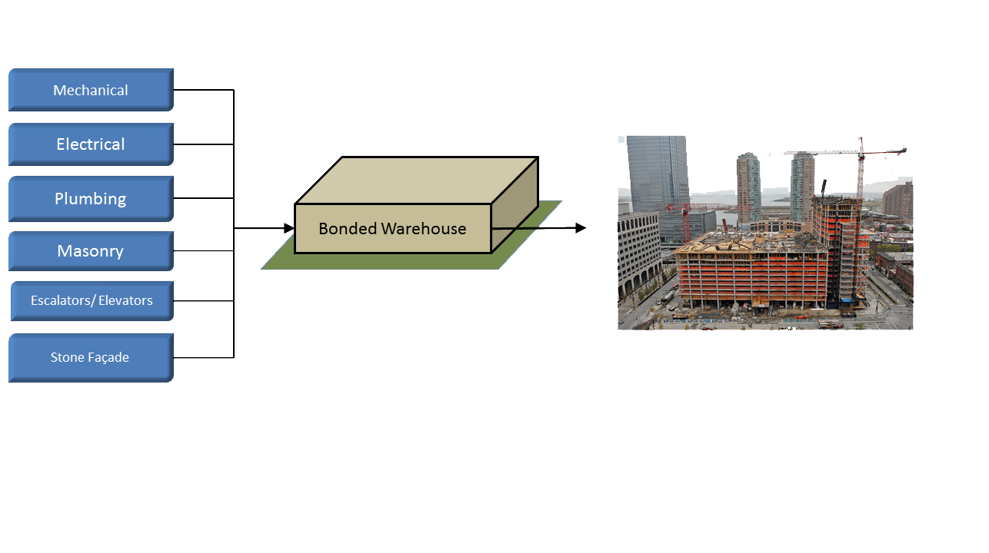

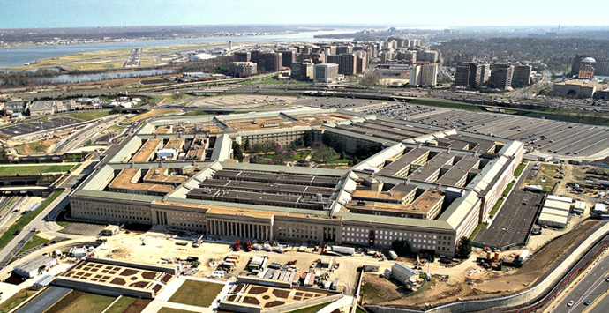
Equipment Staging and Bonded Warehouses
Reston Station Phase 1 Garage
Reston, Virginia
Jon Fisher | Construction Management
OUTLINE
Project Overview
Analysis #1: Public-Private Partnerships
Analysis #2: Bonded Warehouses
Analysis #3: SIPS Scheduling
Analysis #4: Mechanical Chases
Summary and Conclusions
Acknowledgements
Using Bonded Warehouses as a HUB
All deliveries to bonded warehouse
Could be used for multiple projects
Long-term lease
Pentagon Renovation Example
Bonded Warehouses as HUBs

Slide 16
Equipment Staging and Bonded Warehouses
Reston Station Phase 1 Garage
Reston, Virginia
Jon Fisher | Construction Management
OUTLINE
Project Overview
Analysis #1: Public-Private Partnerships
Analysis #2: Bonded Warehouses
Analysis #3: SIPS Scheduling
Analysis #4: Mechanical Chases
Summary and Conclusions
Acknowledgements
Costs
Added staff and equipment
36 month lease
Bonding on warehouse
Total Cost of Off Long Term Off Site Storage
Storage Cost | $ 896,019.48
Transportation Cost | $ 162,020.00
Staff | $ 660,000.00
TOTAL | $ 1,718,039.48
Bonded Warehouses as HUBs
Compared to $36,000 for short term use

Slide 17
Equipment Staging and Bonded Warehouses
Reston Station Phase 1 Garage
Reston, Virginia
Jon Fisher | Construction Management
OUTLINE
Project Overview
Analysis #1: Public-Private Partnerships
Analysis #2: Bonded Warehouses
Analysis #3: SIPS Scheduling
Analysis #4: Mechanical Chases
Summary and Conclusions
Acknowledgements
Comparing Costs
Per Month Comparison of Bonded Warehouse Use
Scenario | Time Span (mo.) | Cost | Cost/Mo
Warehouse Leasing | 36 | $ 1,718,039.48 | $ 47,723.32
Short Term Warehouse Space Usage | 6 | $ 36,236.00 | $ 6,039.33
Limited Bonded Warehouse Use
Short term time span from construction schedule
Warehouse leasing option = 1.5% project budget
Minimized impact if used by several projects
Extensive Bonded Warehouse Use

Slide 18
Equipment Staging and Bonded Warehouses
Reston Station Phase 1 Garage
Reston, Virginia
Jon Fisher | Construction Management
OUTLINE
Project Overview
Analysis #1: Public-Private Partnerships
Analysis #2: Bonded Warehouses
Analysis #3: SIPS Scheduling
Analysis #4: Mechanical Chases
Summary and Conclusions
Acknowledgements
Advantages
Reduced Risk
Consolidated Delivery
Early Subcontractor cash flow
Eliminates delays in Production
Comparing Costs
Per Month Comparison of Bonded Warehouse Use
Scenario | Time Span (mo.) | Cost | Cost/Mo
Warehouse Leasing | 36 | $ 1,718,039.48 | $ 47,723.32
Short Term Warehouse Space Usage | 6 | $ 36,236.00 | $ 6,039.33
Value of Goods Being Stored and Transported
Item | Cost | Quantity | Unit |  | Total
Granite Stone Façade | $ 18.00 | 10200 | SF |  | $ 183,600.00
Garage Supply Air Fans | $ 3,140.00 | 50 | Ea |  | $ 157,000.00
Garage Exhaust Air Fans | $ 2,700.00 | 90 | Ea |  | $ 243,000.00
Escalator Trusses | $ 110,000.00 | 2 | Ea |  | $ 220,000.00
 |  |  |  | TOTAL | $ 803,600.00
Short term time span from construction schedule
Warehouse leasing option = 1.5% project budget
Minimized impact if used by several projects
$800,000 OF MATERIALS

Slide 19
Equipment Staging and Bonded Warehouses
Reston Station Phase 1 Garage
Reston, Virginia
Jon Fisher | Construction Management
OUTLINE
Project Overview
Analysis #1: Public-Private Partnerships
Analysis #2: Bonded Warehouses
Analysis #3: SIPS Scheduling
Analysis #4: Mechanical Chases
Summary and Conclusions
Acknowledgements
Conclusion
Advantages
Reduced Risk
Consolidated Delivery
Early Subcontractor cash flow
Eliminates delays in Production
Recommendation: Implementation of warehouse as month-to-month storage for escalators, stone, and fans will mitigate risk and help site production at Reston.
Leasing warehouse as HUB space is cost prohibitive
Better suited for when required or serving multiple projects
Value of Goods Being Stored and Transported
Item | Cost | Quantity | Unit |  | Total
Granite Stone Façade | $ 18.00 | 10200 | SF |  | $ 183,600.00
Garage Supply Air Fans | $ 3,140.00 | 50 | Ea |  | $ 157,000.00
Garage Exhaust Air Fans | $ 2,700.00 | 90 | Ea |  | $ 243,000.00
Escalator Trusses | $ 110,000.00 | 2 | Ea |  | $ 220,000.00
 |  |  |  | TOTAL | $ 803,600.00
$800,000 OF MATERIALS

Slide 20
Short Interval Production Scheduling
Reston Station Phase 1 Garage
Reston, Virginia
Jon Fisher | Construction Management
OUTLINE
Project Overview
Analysis #1: Public-Private Partnerships
Analysis #2: Bonded Warehouses
Analysis #3: SIPS Scheduling
Analysis #4: Mechanical Chases
Summary and Conclusions
Acknowledgements
Goal of Analysis #3
To utilize Short Interval Production Scheduling (SIPS) and matrix scheduling to accelerate and illustrate garage finish sequence

Slide 21
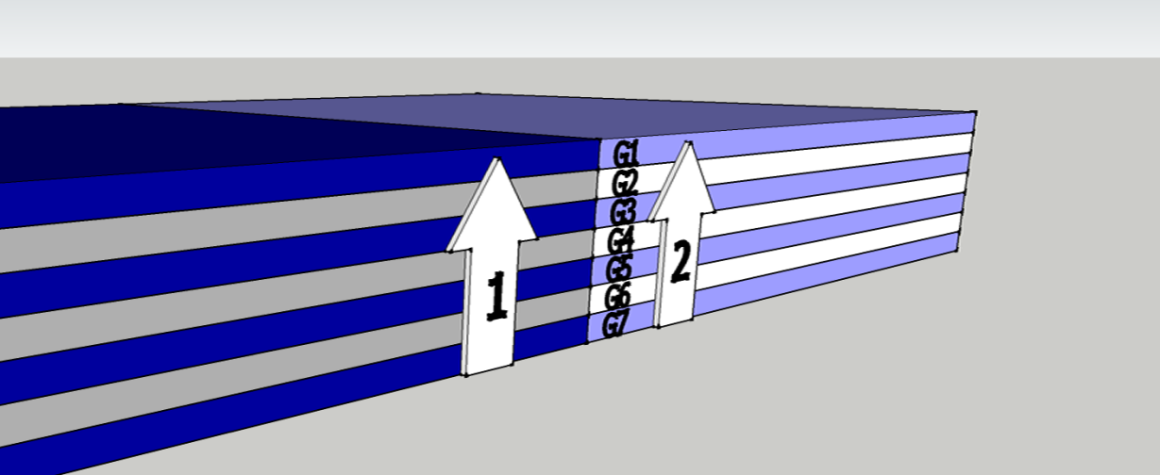
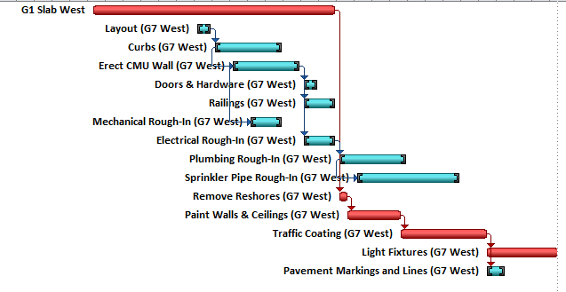
Short Interval Production Scheduling
Reston Station Phase 1 Garage
Reston, Virginia
Jon Fisher | Construction Management
OUTLINE
Project Overview
Analysis #1: Public-Private Partnerships
Analysis #2: Bonded Warehouses
Analysis #3: SIPS Scheduling
Analysis #4: Mechanical Chases
Summary and Conclusions
Acknowledgements
Original Finish Sequence
Original Finish Sequence
Each level divided by East and West
Original zones = 99,000 SF
Concrete sequence determined finish sequence
Reshore restrictions defined finish schedule

Slide 22
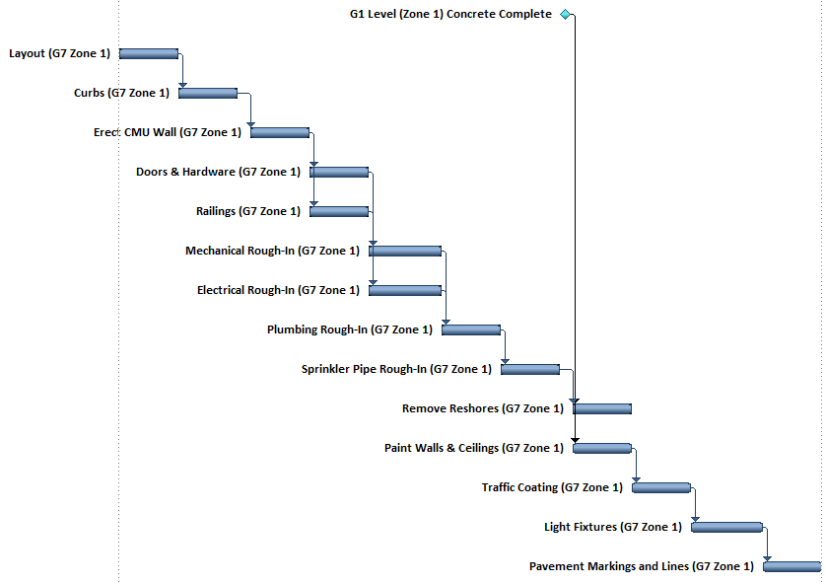
Short Interval Production Scheduling
Reston Station Phase 1 Garage
Reston, Virginia
Jon Fisher | Construction Management
OUTLINE
Project Overview
Analysis #1: Public-Private Partnerships
Analysis #2: Bonded Warehouses
Analysis #3: SIPS Scheduling
Analysis #4: Mechanical Chases
Summary and Conclusions
Acknowledgements
Adjusted Sequence
Original Finish Sequence
Simplified sequence
Includes co-location of certain trades
Reshore restrictions defined finish schedule

Slide 23
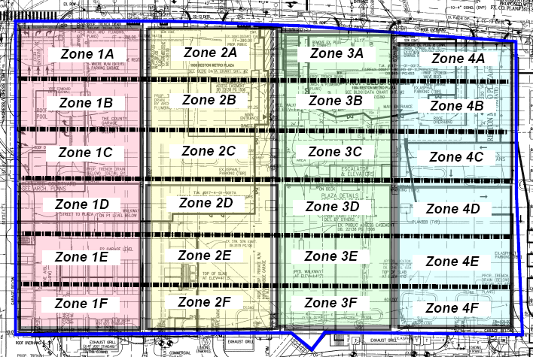
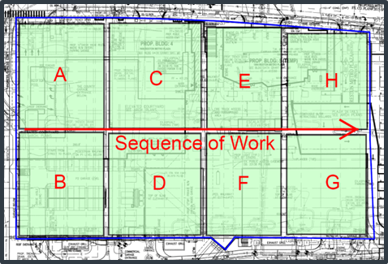
Short Interval Production Scheduling
Reston Station Phase 1 Garage
Reston, Virginia
Jon Fisher | Construction Management
OUTLINE
Project Overview
Analysis #1: Public-Private Partnerships
Analysis #2: Bonded Warehouses
Analysis #3: SIPS Scheduling
Analysis #4: Mechanical Chases
Summary and Conclusions
Acknowledgements
Redefined Zones
Adjusted Sequence
Simplified sequence
Includes co-location of certain trades
Takes most advantage of concrete sequence
Each Subzone = 8,250 Square Feet

Slide 24
Short Interval Production Scheduling
Reston Station Phase 1 Garage
Reston, Virginia
Jon Fisher | Construction Management
OUTLINE
Project Overview
Analysis #1: Public-Private Partnerships
Analysis #2: Bonded Warehouses
Analysis #3: SIPS Scheduling
Analysis #4: Mechanical Chases
Summary and Conclusions
Acknowledgements
Productivity Rates and Crew Adjustment
Redefined Zones
Garage Activity Productivity Rates
Schedule Indicator | Activity | Baseline Duration (Days) | Productivity (SF/Man/Day) | SIPS Subzone Area | # of Workers (SIPS)
A | Layout | 5 | 9900 | 8250 SF | 2
B | Curbs | 20 | 413 |  | 20
C | CMU Walls | 20 | 620 |  | 14
D | Doors & Hardware | 5 | 9900 |  | 2
 | Railings | 10 | 3300 |  | 3
E | Mech Rough In | 10 | 2475 |  | 4
 | Electrical Rough In | 10 | 1650 |  | 6
F | Plumbing Rough In | 20 | 495 |  | 17
G | Sprikler Rough In | 30 | 825 |  | 10
H | Remove Reshores | 3 | 8250 |  | 4
 | Paint Walls and Ceilings | 15 | 660 |  | 13
I | Traffic Coating | 24 | 1094 |  | 8
J | Light Fixtures | 20 | 825 |  | 10
K | Pavement Markings | 5 | 3300 |  | 6
Crew sizes adjusted to achieve 1 subzone/day
Some crew sizes were “irreducible”
Takes most advantage of concrete sequence
Each Subzone = 8,250 Square Feet

Slide 25
Short Interval Production Scheduling
Reston Station Phase 1 Garage
Reston, Virginia
Jon Fisher | Construction Management
OUTLINE
Project Overview
Analysis #1: Public-Private Partnerships
Analysis #2: Bonded Warehouses
Analysis #3: SIPS Scheduling
Analysis #4: Mechanical Chases
Summary and Conclusions
Acknowledgements
Productivity Rates and Crew Adjustment
“Perfect” Matrix
Garage Activity Productivity Rates
Schedule Indicator | Activity | Baseline Duration (Days) | Productivity (SF/Man/Day) | SIPS Subzone Area | # of Workers (SIPS)
A | Layout | 5 | 9900 | 8250 SF | 2
B | Curbs | 20 | 413 |  | 20
C | CMU Walls | 20 | 620 |  | 14
D | Doors & Hardware | 5 | 9900 |  | 2
 | Railings | 10 | 3300 |  | 3
E | Mech Rough In | 10 | 2475 |  | 4
 | Electrical Rough In | 10 | 1650 |  | 6
F | Plumbing Rough In | 20 | 495 |  | 17
G | Sprikler Rough In | 30 | 825 |  | 10
H | Remove Reshores | 3 | 8250 |  | 4
 | Paint Walls and Ceilings | 15 | 660 |  | 13
I | Traffic Coating | 24 | 1094 |  | 8
J | Light Fixtures | 20 | 825 |  | 10
K | Pavement Markings | 5 | 3300 |  | 6
Crew sizes adjusted to achieve 1 subzone/day
Some crew sizes were “irreducible”
168 Zones
Duration: 178 Days

Slide 26
Short Interval Production Scheduling
Reston Station Phase 1 Garage
Reston, Virginia
Jon Fisher | Construction Management
OUTLINE
Project Overview
Analysis #1: Public-Private Partnerships
Analysis #2: Bonded Warehouses
Analysis #3: SIPS Scheduling
Analysis #4: Mechanical Chases
Summary and Conclusions
Acknowledgements
Concrete Impact
“Perfect” Matrix
11 Days
18 Days
2 framed + 4 reshored levels required
Painting and traffic coating delayed by reshores
168 Zones
Duration: 178 Days

Slide 27
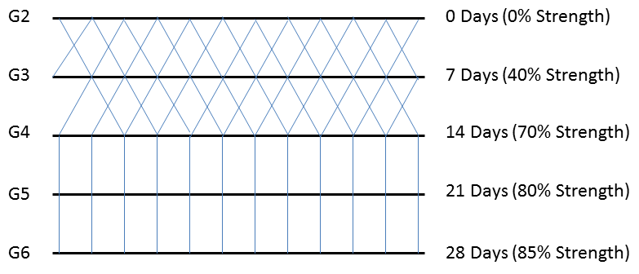
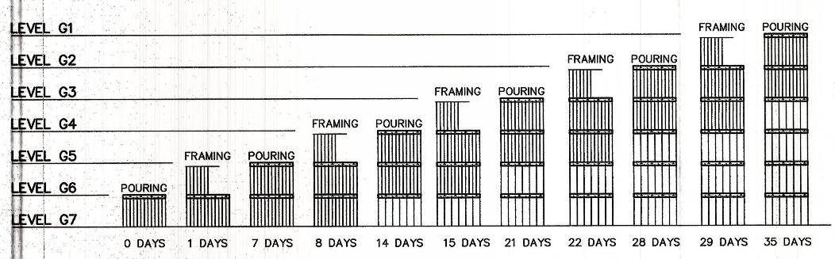
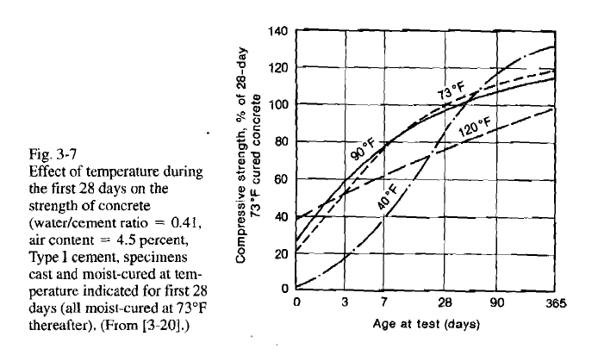
Short Interval Production Scheduling
Reston Station Phase 1 Garage
Reston, Virginia
Jon Fisher | Construction Management
OUTLINE
Project Overview
Analysis #1: Public-Private Partnerships
Analysis #2: Bonded Warehouses
Analysis #3: SIPS Scheduling
Analysis #4: Mechanical Chases
Summary and Conclusions
Acknowledgements
Structural Breadth
Combined
Capacity
Combined
Loading
>
Original 2+4 Requirement
Redesign of slab to achieve 2+2
ACI 318-11
  Deflections
  Punching Shear
ASCE 37
Slab Dead Load (10” slab) = 125 PSF
Formwork = 10 PSF
Reshores = 5 PSF
Construction Live Load = 75 PSF

Slide 28
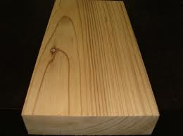
Short Interval Production Scheduling
Reston Station Phase 1 Garage
Reston, Virginia
Jon Fisher | Construction Management
OUTLINE
Project Overview
Analysis #1: Public-Private Partnerships
Analysis #2: Bonded Warehouses
Analysis #3: SIPS Scheduling
Analysis #4: Mechanical Chases
Summary and Conclusions
Acknowledgements
Structural Breadth
Original 2+4 Requirement
Redesign of slab to achieve 2+2
ACI 318-11
  Deflections
  Punching Shear
10” Slab with 5.5” Drop Panel Meets Requirements
5.5” drop panel allows for dimensional 2x6 form work
Saves time and labor

Slide 29
Short Interval Production Scheduling
Reston Station Phase 1 Garage
Reston, Virginia
Jon Fisher | Construction Management
OUTLINE
Project Overview
Analysis #1: Public-Private Partnerships
Analysis #2: Bonded Warehouses
Analysis #3: SIPS Scheduling
Analysis #4: Mechanical Chases
Summary and Conclusions
Acknowledgements
Conclusion
SIPS REQUIRES COORDINATION
Concrete progress had big impact on finishes
Early completion means lower general conditions
Crew size adjustments impact cost curve
Slab redesign with SIPS = $2,350/saved day
Liquidated Damages = approx. $10,000/day after Substantial Completion
Financially beneficial to owner
SIPS Schedule Results
Finish Scenario | Start | Finish | Duration | Saved Duration | Days Complete Before BL Finish | Cost Increase
Baseline Schedule | 14-Feb-12 | 5-Feb-13 | 256 | - | - | $ -
"Perfect" Matrix | 14-Feb-12 | 18-Oct-12 | 178 | 78 | 78 Days | $ -
SIPS w/ 4+2 Shoring | 14-Feb-12 | 13-Nov-12 | 196 | 60 | 60 Days | $ -
SIPS w/ 2+2 Shoring | 2-Jan-12 | 10-Oct-12 | 203 | 53 | 85 Days | $ 200,000.00

Slide 30
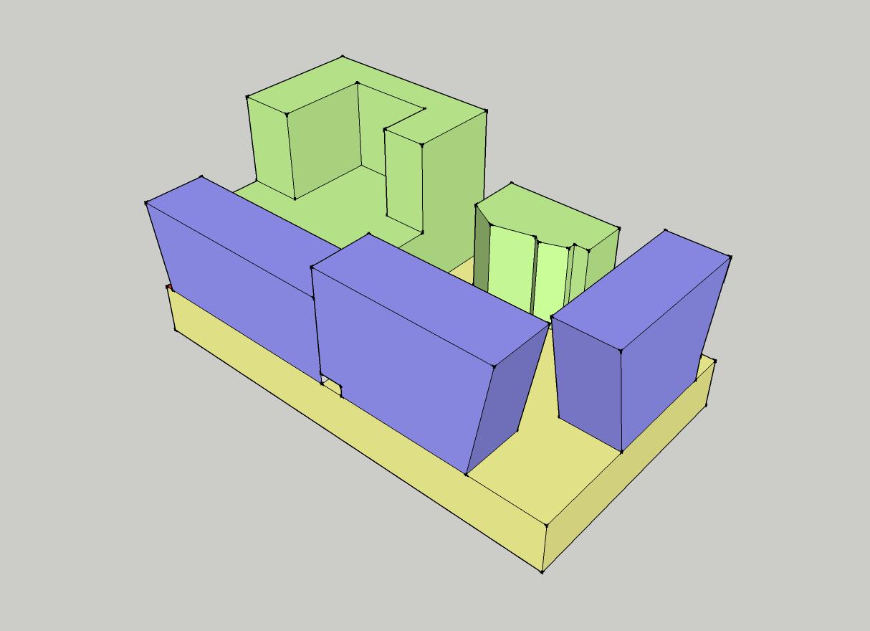
Mechanical Chases and Design Coordination
Reston Station Phase 1 Garage
Reston, Virginia
Jon Fisher | Construction Management
OUTLINE
Project Overview
Analysis #1: Public-Private Partnerships
Analysis #2: Bonded Warehouses
Analysis #3: SIPS Scheduling
Analysis #4: Mechanical Chases
Summary and Conclusions
Acknowledgements
Design Coordination
Goal of Analysis #4
To assess the impacts of adding mechanical pipe chases to the garage on design coordination and project cost.
Architect - Hickok Cole
Structural - Structura
MEP - Hoffman Borowski
Architect – Davis, Carter, Scott
Structural – Luis Fernandez
MEP – Jordan & Skala
Architect – Murphy/Jahn
Structural – Thorton Thomasetti
MEP – GHT Chartered
3 Separate Design Teams
Penetration Coordination difficult with varying stages of design

Slide 31
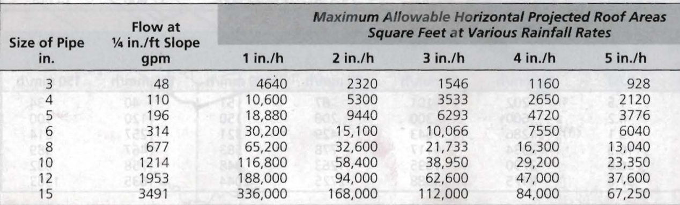
Mechanical Chases and Design Coordination
Reston Station Phase 1 Garage
Reston, Virginia
Jon Fisher | Construction Management
OUTLINE
Project Overview
Analysis #1: Public-Private Partnerships
Analysis #2: Bonded Warehouses
Analysis #3: SIPS Scheduling
Analysis #4: Mechanical Chases
Summary and Conclusions
Acknowledgements
Mechanical Breadth
Roof Drains
Reston 100 Year Storm = 3”/hour
Flat Roof Slope = ¼” / Ft.
Assumes Consolidation to 1 Pipe

Slide 32
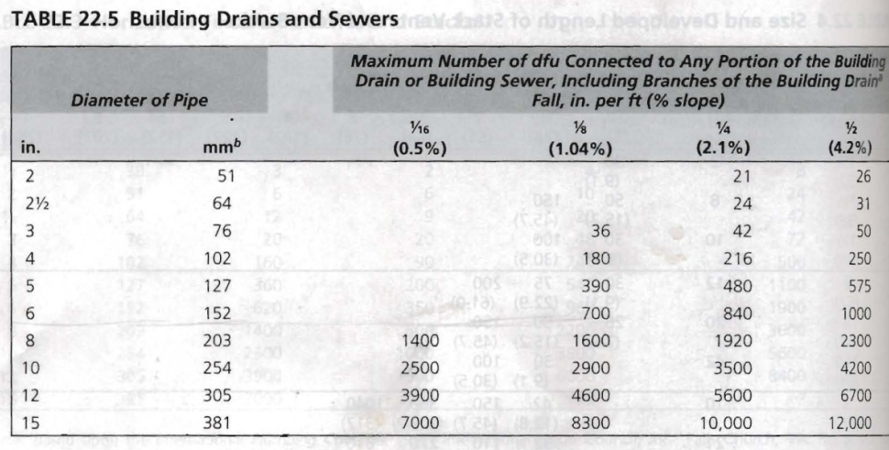
Mechanical Chases and Design Coordination
Reston Station Phase 1 Garage
Reston, Virginia
Jon Fisher | Construction Management
OUTLINE
Project Overview
Analysis #1: Public-Private Partnerships
Analysis #2: Bonded Warehouses
Analysis #3: SIPS Scheduling
Analysis #4: Mechanical Chases
Summary and Conclusions
Acknowledgements
Mechanical Breadth
Sanitary Drains
Roof Drains
Slope of Drain Pipe = 1/8” / ft
Assumes Consolidation to 1 Pipe
Exception: 2 Pipes in Apartment due to excessive drop
Reston 100 Year Storm = 3”/hour
Flat Roof Slope = ¼” / Ft.
Assumes Consolidation to 1 Pipe

Slide 33
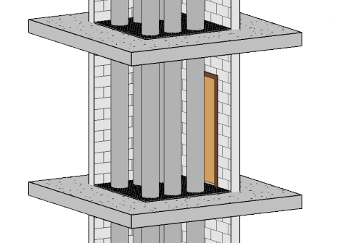
Mechanical Chases and Design Coordination
Reston Station Phase 1 Garage
Reston, Virginia
Jon Fisher | Construction Management
OUTLINE
Project Overview
Analysis #1: Public-Private Partnerships
Analysis #2: Bonded Warehouses
Analysis #3: SIPS Scheduling
Analysis #4: Mechanical Chases
Summary and Conclusions
Acknowledgements
Chase Design
8” CMU Partition Walls
Outward Swinging Doors
Steel Grating
6’ x 8’

Slide 34
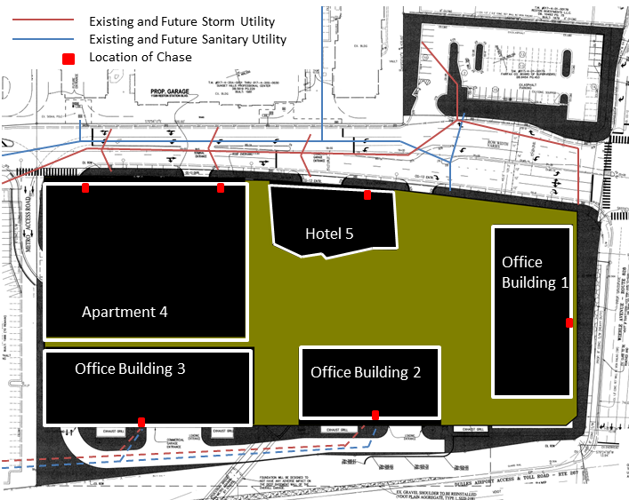
Mechanical Chases and Design Coordination
Reston Station Phase 1 Garage
Reston, Virginia
Jon Fisher | Construction Management
OUTLINE
Project Overview
Analysis #1: Public-Private Partnerships
Analysis #2: Bonded Warehouses
Analysis #3: SIPS Scheduling
Analysis #4: Mechanical Chases
Summary and Conclusions
Acknowledgements
Location For Chases
The Good
Perimeter locations simplify connection to exterior
Could coincide with stairwell or elevator shaft location
The Bad
10 Public and 12 Private Parking Spaces lost

Slide 35
Mechanical Chases and Design Coordination
Reston Station Phase 1 Garage
Reston, Virginia
Jon Fisher | Construction Management
OUTLINE
Project Overview
Analysis #1: Public-Private Partnerships
Analysis #2: Bonded Warehouses
Analysis #3: SIPS Scheduling
Analysis #4: Mechanical Chases
Summary and Conclusions
Acknowledgements
Recommendation
Cost prohibitive
Further investigation needed for achieving better design coordination efforts
The Ugly
Cost of Chases
Item | Unit | Quantity | Labor (Unit Cost) | Material (Unit Cost) | Equipment | Total Labor | Total Material | Total Equipment
Steel Grating | SF | 1008 | $ 14.85 | $ 4.50 | $ 2.49 | $ 14,968.80 | $ 4,536.00 | $ 2,509.92
Steel Angles | Ea | 56 | $ 56.00 | $ 29.50 | $ - | $ 3,136.00 | $ 1,652.00 | $ -
HM Doors | Ea | 28 | $ 560.00 | $ 39.00 | $ - | $ 15,680.00 | $ 1,092.00 | $ -
HM Frames | Ea | 28 | $ 199.00 | $ 44.00 | $ - | $ 5,572.00 | $ 1,232.00 | $ -
CMU Block | SF | 6688 | $ 2.40 | $ 4.34 | $ - | $ 16,051.20 | $ 29,025.92 | $ -
Concrete Expansion Anchors | Ea | 280 | $ 2.38 | $ 3.07 | $ - | $ 666.40 | $ 859.60 | $ -
 |  |  |  |  | Total | $ 56,074.40 | $ 38,397.52 | $ 2,509.92
 |  |  |  |  | Tax |  | $ 2,303.85
 |  |  |  |  | Total | $ 99,285.69
Chase Cost = $99,000
12" Core Drills
unit | Quantity | Material | Labor | Equipment | Total Cost
Ea | 132 | $ 2.75 | $ 71.02 | $ 12.16 | $ 11,001.54
Core Drill Cost = $11,000

Slide 36
Conclusions
Reston Station Phase 1 Garage
Reston, Virginia
Jon Fisher | Construction Management
OUTLINE
Project Overview
Analysis #1: Public-Private Partnerships
Analysis #2: Bonded Warehouses
Analysis #3: SIPS Scheduling
Analysis #4: Mechanical Chases
Summary and Conclusions
Acknowledgements
Final Conclusions
Public-Private Partnerships: Good research, caution needed when working with a PPP
Bonded Warehouses: Shows benefit for month-to-month short term needs but leasing is cost prohibitive for Reston
SIPS Scheduling: Biggest impact on schedule comes from design delays. SIPS could have helped in hindsight.
Mechanical Chases: Cost prohibitive

Slide 37
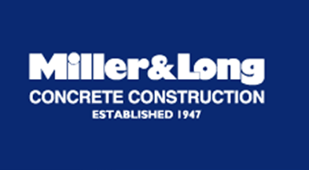
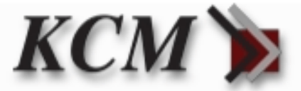
Acknowledgements
Reston Station Phase 1 Garage
Reston, Virginia
Jon Fisher | Construction Management
OUTLINE
Project Overview
Analysis #1: Public-Private Partnerships
Analysis #2: Bonded Warehouses
Analysis #3: SIPS Scheduling
Analysis #4: Mechanical Chases
Summary and Conclusions
Acknowledgements
Penn State Architectural Engineering Faculty
Friends, Family and God
Industry Members

Slide 38
Questions?

Slide 39
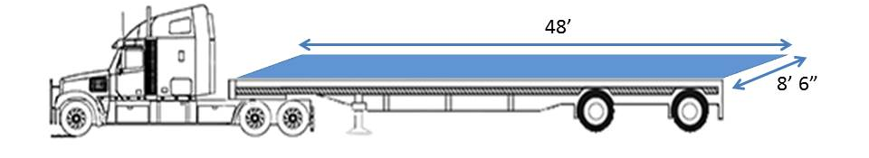
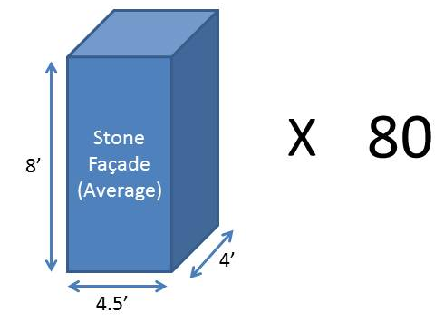
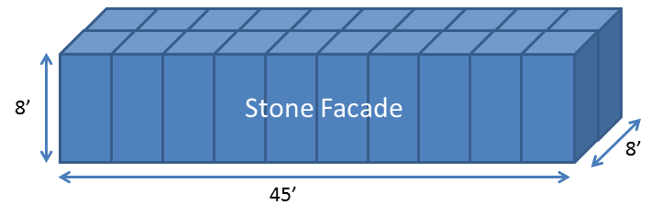
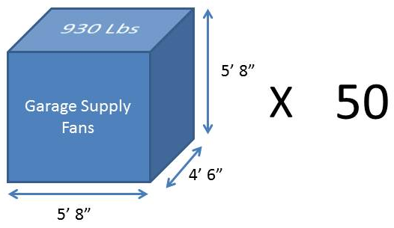
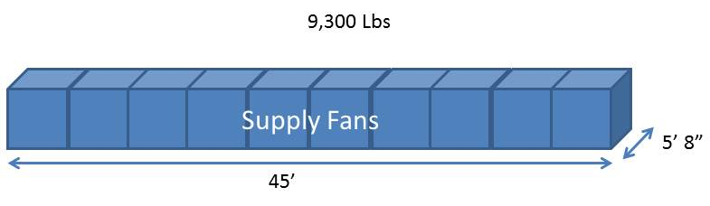

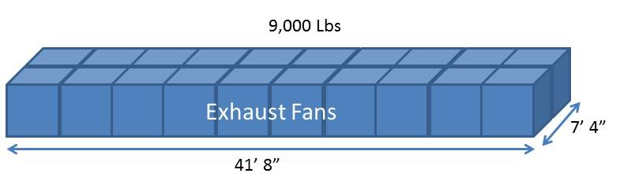
Appendix (Bonded Warehouses)
Reston Station Phase 1 Garage
Reston, Virginia
Jon Fisher | Construction Management
OUTLINE

Slide 40
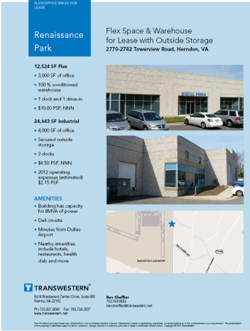
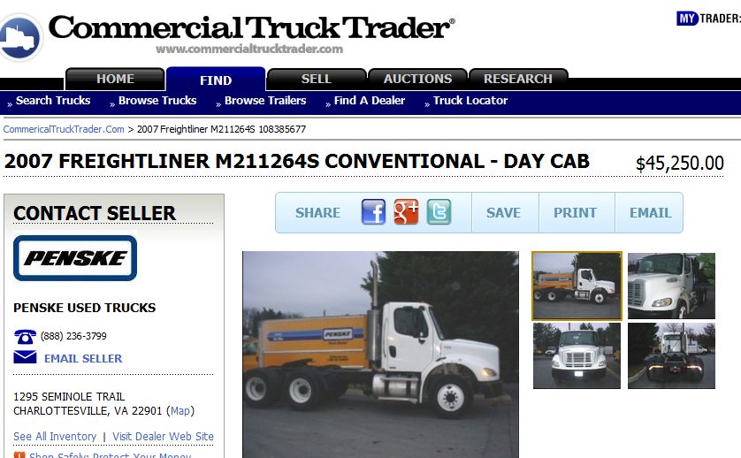
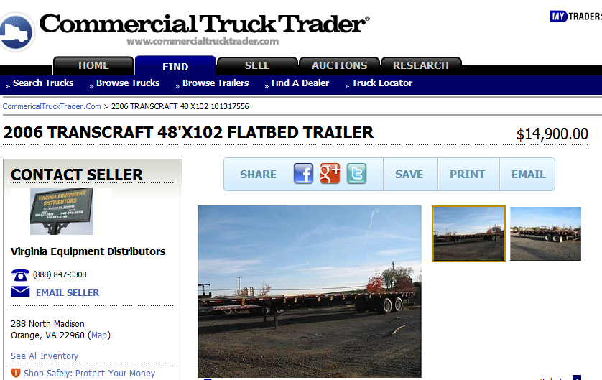
Appendix (Bonded Warehouses)
Reston Station Phase 1 Garage
Reston, Virginia
Jon Fisher | Construction Management
OUTLINE

Slide 41
Appendix (SIPS)
Reston Station Phase 1 Garage
Reston, Virginia
Jon Fisher | Construction Management
OUTLINE
Project Overview
Analysis #1: Public-Private Partnerships
Analysis #2: Bonded Warehouses
Analysis #3: SIPS Scheduling
Analysis #4: Mechanical Chases
Summary and Conclusions
Acknowledgements
Appendix
Level | Subzone | 14-Feb | 15-Feb | 16-Feb | 17-Feb | 20-Feb | 21-Feb | 22-Feb | 23-Feb | 24-Feb | 27-Feb | 28-Feb | 29-Feb | 1-Mar | 2-Mar | 5-Mar | 6-Mar | 7-Mar | 8-Mar | 9-Mar | 12-Mar | 13-Mar | 14-Mar | 15-Mar | 16-Mar | 19-Mar | 20-Mar | 21-Mar | 22-Mar | 23-Mar | 26-Mar | 27-Mar | 28-Mar | 29-Mar | 30-Mar
G7 | 1A | A | B | C | D | E | F | G | H | Crew 1 |  |  |  | J | K
G7 | 1B |  | A | B | C | D | E | F | G | H | Crew 2 |  |  |  | J | K
G7 | 1C |  |  | A | B | C | D | E | F | G | H | Crew 3 |  |  |  | J | K
G7 | 1D |  |  |  | A | B | C | D | E | F | G | H | Crew 4 |  |  |  | J | K
G7 | 1E |  |  |  |  | A | B | C | D | E | F | G | H | Crew 1 |  |  |  | J | K
G7 | 1F |  |  |  |  |  | A | B | C | D | E | F | G | H | I | I | I | I | J | K
G7 | 2A |  |  |  |  |  |  | A | B | C | D | E | F | G | H | I | I | I | I | J | K
G7 | 2B |  |  |  |  |  |  |  | A | B | C | D | E | F | G | H | I | I | I | I | J | K
G7 | 2C |  |  |  |  |  |  |  |  | A | B | C | D | E | F | G | H | I | I | I | I | J | K
G7 | 2D |  |  |  |  |  |  |  |  |  | A | B | C | D | E | F | G | H | I | I | I | I | J | K
G7 | 2E |  |  |  |  |  |  |  |  |  |  | A | B | C | D | E | F | G | H | I | I | I | I | J | K
G7 | 2F |  |  |  |  |  |  |  |  |  |  |  | A | B | C | D | E | F | G | H | I | I | I | I | J | K
G6 | 1A |  |  |  |  |  |  |  |  |  |  |  |  | A | B | C | D | E | F | G | H | I | I | I | I | J | K
G6 | 1B |  |  |  |  |  |  |  |  |  |  |  |  |  | A | B | C | D | E | F | G | H | I | I | I | I | J | K
G6 | 1C |  |  |  |  |  |  |  |  |  |  |  |  |  |  | A | B | C | D | E | F | G | H | I | I | I | I | J | K
G6 | 1D |  |  |  |  |  |  |  |  |  |  |  |  |  |  |  | A | B | C | D | E | F | G | H | I | I | I | I | J | K
G6 | 1E |  |  |  |  |  |  |  |  |  |  |  |  |  |  |  |  | A | B | C | D | E | F | G | H | I | I | I | I | J | K
G6 | 1F |  |  |  |  |  |  |  |  |  |  |  |  |  |  |  |  |  | A | B | C | D | E | F | G | H | I | I | I | I | J | K
G6 | 2A |  |  |  |  |  |  |  |  |  |  |  |  |  |  |  |  |  |  | A | B | C | D | E | F | G | H | I | I | I | I | J | K
G6 | 2B |  |  |  |  |  |  |  |  |  |  |  |  |  |  |  |  |  |  |  | A | B | C | D | E | F | G | H | I | I | I | I | J | K
G6 | 2C |  |  |  |  |  |  |  |  |  |  |  |  |  |  |  |  |  |  |  |  | A | B | C | D | E | F | G | H | I | I | I | I | J | K
G6 | 2D |  |  |  |  |  |  |  |  |  |  |  |  |  |  |  |  |  |  |  |  |  | A | B | C | D | E | F | G | H | I | I | I | I | J
G6 | 2E |  |  |  |  |  |  |  |  |  |  |  |  |  |  |  |  |  |  |  |  |  |  | A | B | C | D | E | F | G | H | I | I | I | I
G6 | 2F |  |  |  |  |  |  |  |  |  |  |  |  |  |  |  |  |  |  |  |  |  |  |  | A | B | C | D | E | F | G | H | I | I | I

Slide 42
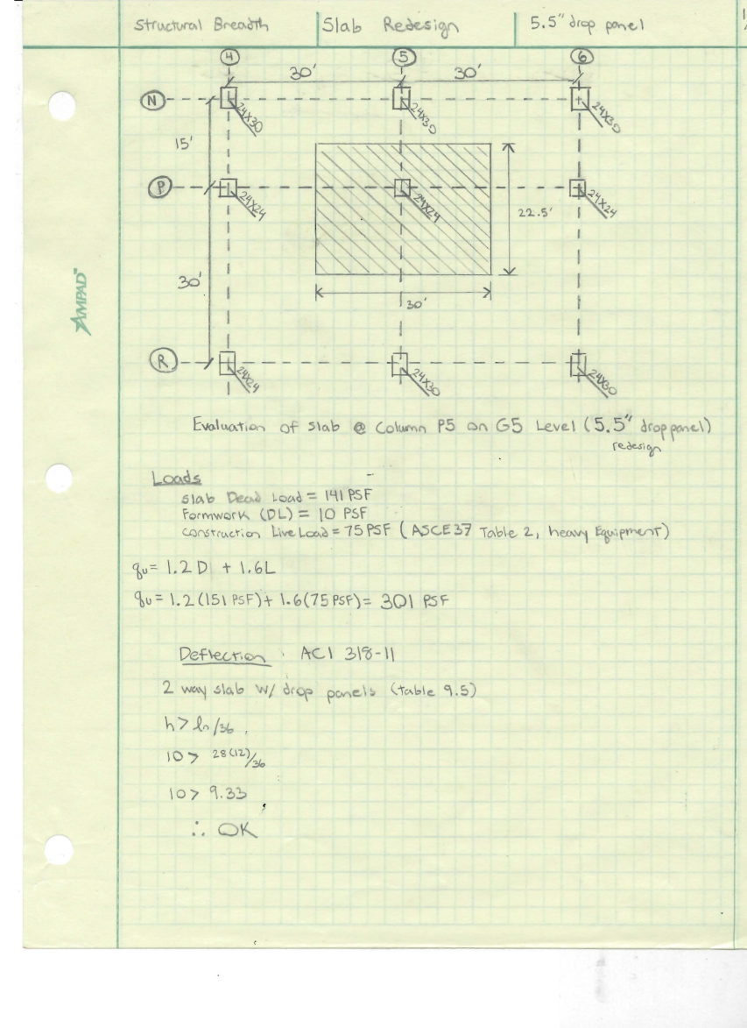
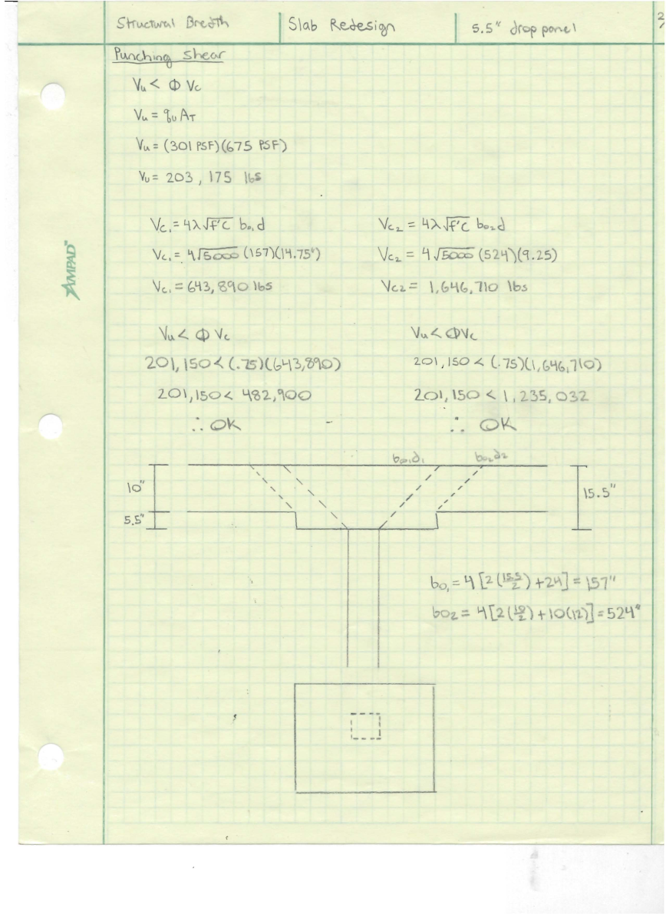
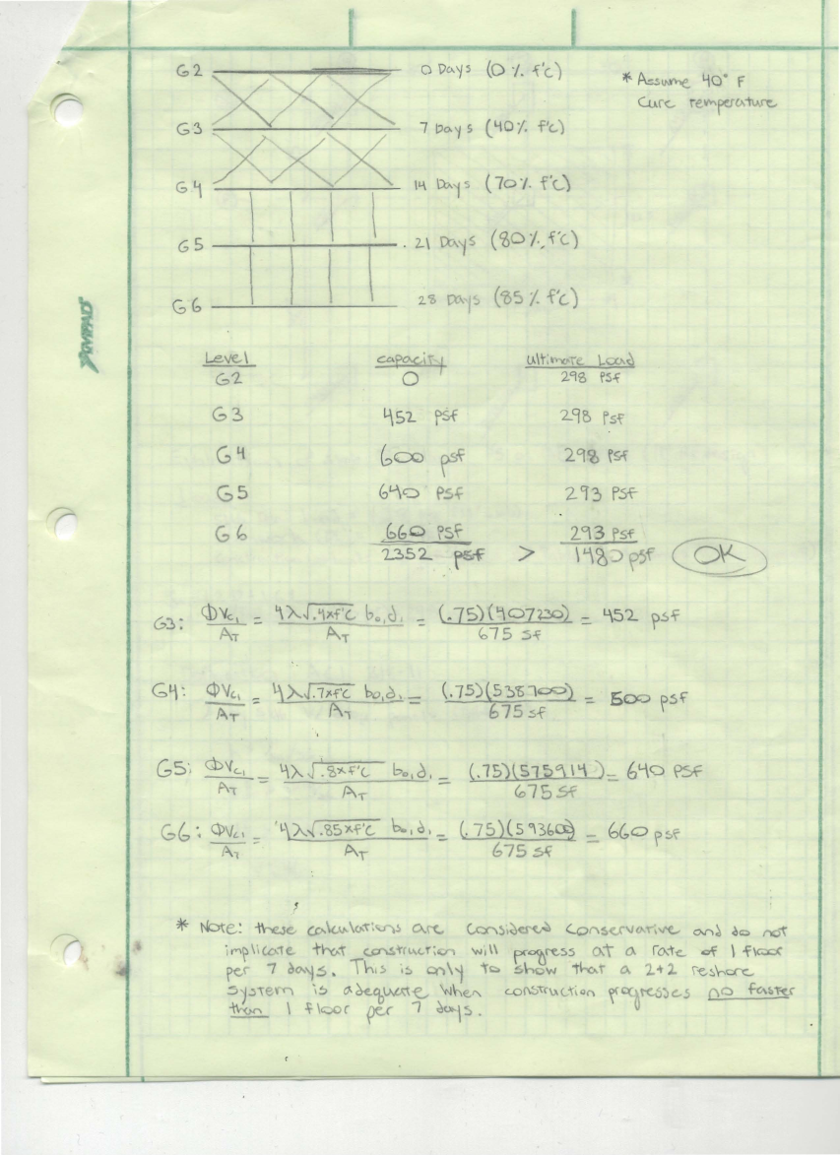
Appendix (SIPS)
Reston Station Phase 1 Garage
Reston, Virginia
Jon Fisher | Construction Management
OUTLINE
Project Overview
Analysis #1: Public-Private Partnerships
Analysis #2: Bonded Warehouses
Analysis #3: SIPS Scheduling
Analysis #4: Mechanical Chases
Summary and Conclusions
Acknowledgements
Appendix

Slide 43
Appendix (Mechanical Chases)
Reston Station Phase 1 Garage
Reston, Virginia
Jon Fisher | Construction Management
OUTLINE

